Slide 1
Employee Data Analysis using Excel
STUDENT NAME:YOGESWARI E
REGISTER NO: 312200278
DEPARTMENT: B.COM (ACCOUNTING & FINANCE)
NAAN MUDHALVAN ID: asunm103unm103312200278
COLLEGE: S.I.V.E.T.COLLEGE

Slide 2
PROJECT TITLE
Analysis of Employee using Excel

Slide 3


AGENDA
Problem Statement
Project Overview
End Users
Our Solution and Proposition
Dataset Description
Modelling Approach
Results and Discussion
Conclusion
3/21/2024 Annual Review

Slide 4

PROBLEM STATEMENT
Employee compensation involves all the ways your organization gives back to team members for their hard work. The obvious form of compensation is pay, whether it’s salaried, hourly, or sales-based. It’s important that how much an organization financially compensates an employee is fair, especially in terms of balancing the job role itself and the organization’s budget.

Slide 5

PROJECT OVERVIEW
.
Using this we can able to get knowledge about Conditional Formatting ,Pivot Table, Data Manupulation etc.

Slide 6

WHO ARE THE END USERS?
HR Department: Ensures fair and competitive pay.
Executives: Informs salary-related decisions.
Finance: Aligns salary costs with budgets.
Diversity Teams: Monitors pay equity.
Legal Teams: Ensures compliance with regulations.

Slide 7

OUR SOLUTION AND ITS VALUE PROPOSITION
Conditional Formatting: Missing
Pivot Table: Summary
Data Manupulation: Representing data
These tools are used in this project.

Slide 8
Dataset Description
Emp ID
Name
Gender
Department
Salary Start Date
FTE
Employee type
Work location

Slide 9

THE "WOW" IN OUR SOLUTION
It helps the management to analyze the data’s of the employee and their salaries, for the record and understanding the information that have been recorded and it can be used for future purposes
3/21/2024 Annual Review
9

Slide 10
MODELLING
Define Objectives
Data Collection
Data Preprocessing
Exploratory Data Analysis (EDA)
Feature Engineering
Model Selection
Model Training and Evaluation
Interpretability and Insights
10

Slide 11
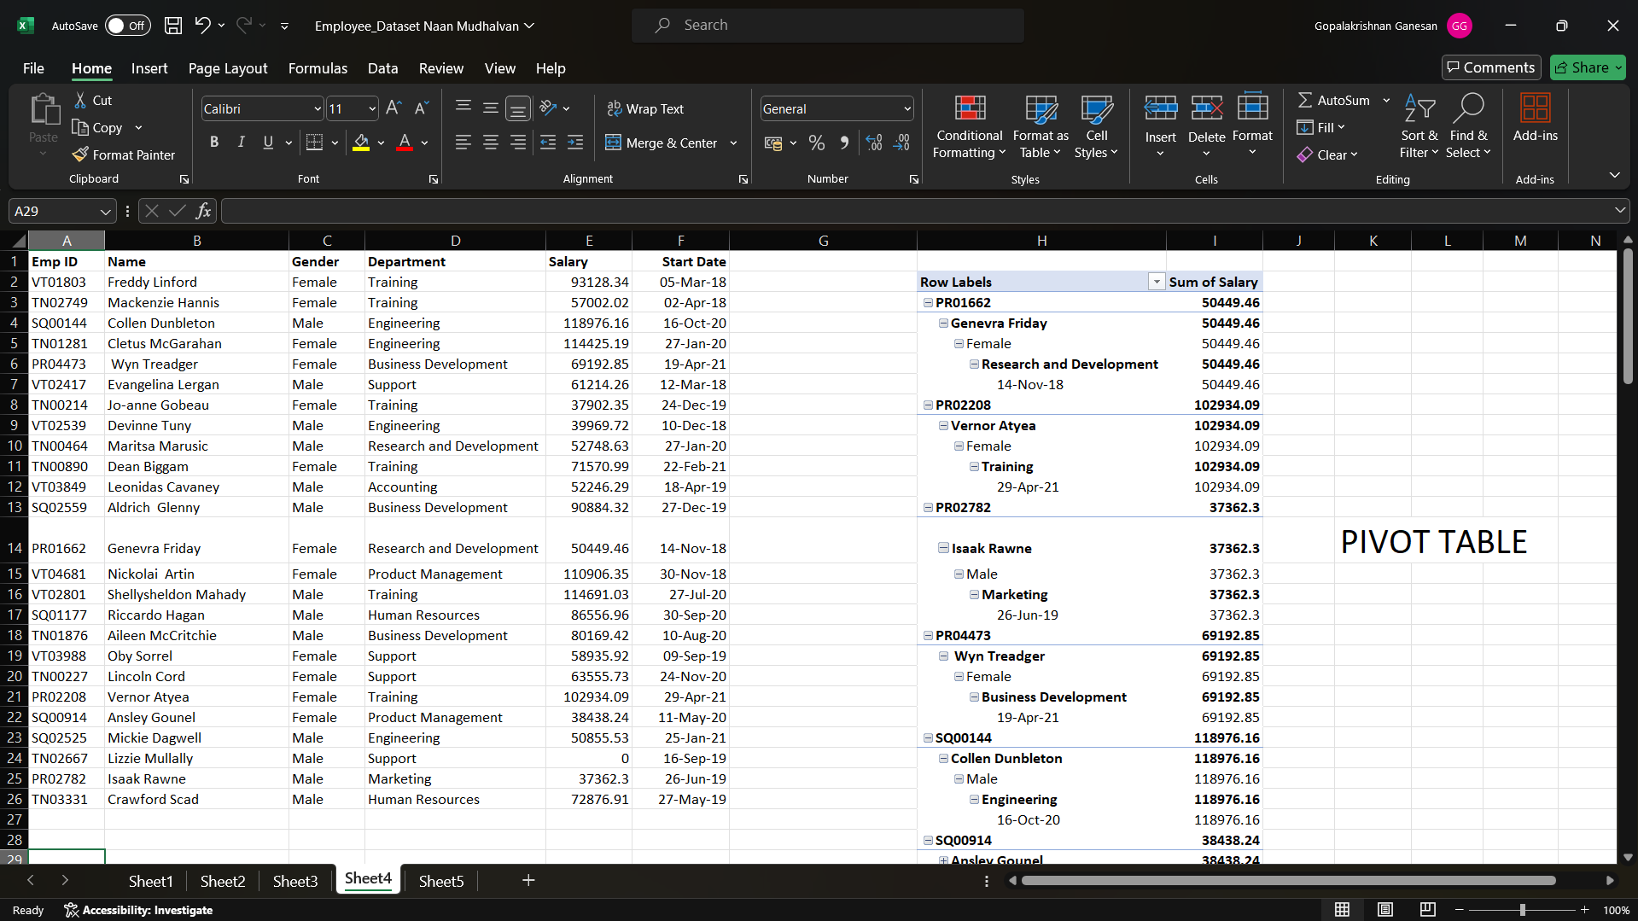
RESULTS
11

Slide 12
CONCLUSION
Key Findings: Summarize the main insights from the analysis, such as average salaries by role, department, or level of experience. Highlight any disparities or trends observed, such as gender pay gaps or inconsistencies across different teams.
Salary Trends: Discuss any patterns, such as increasing or decreasing salary trends over time, which could relate to market demands, company growth, or internal policies.
Performance vs. Compensation: Mention if there’s a correlation between performance metrics and salary levels, indicating whether higher performers are adequately rewarded.
Equity and Fairness: Address any disparities, such as pay inequities related to gender, ethnicity, or other demographic factors. Recommend corrective actions if such disparities exist.
Comparison with Industry Standards: Compare the company’s salary levels with industry benchmarks to determine competitiveness. Highlight areas where the company is leading or lagging.

